Slide 1
VIKINGS
What evidence is there that Vikings came to Norfolk?

Slide 2
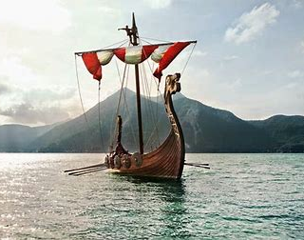
We know that Vikings visited England but did they come to Norfolk specifically and if so when?
In this report, I am going to show you the evidence that Vikings did come to Norfolk.

Slide 3
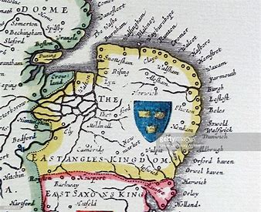
It is thought that the Vikings entered Norfolk in the year 865. Four years later the Vikings slayed king Edmund who was the last king of East Anglia and he was slayed by the Vikings at Hoxne in Suffolk. Even though the Vikings killed him they later honoured him and it was the Viking King Canute who turned his shrine to an Abbey in Bury St Edmunds.
Bury St Edmunds is evidence of Viking presence in East Anglia but in Norfolk there are also place names that show Vikings came to Norfolk. There are 13 different places the Vikings named such as Filby, Hemsby and Thrigby in East Norfolk. These places all end in “by” and in Viking language that means “settlement of”.

Slide 4
Around 200 words we use today came from the Viking language. They taught us words like cake and mug. Historians say that only a big number of invaders could have a big impact on our language.
Other words from their language include most of the days of the week. Apart from Saturday, the rest of the days of the week all have links to Vikings:
Monday was for Mani, the Norse moon god.
Tuesday was for Tyr the Norse one-handed god of war.
Wednesday is Woden’s day, aka Odin the god of wisdom, war, poetry, death and magic.
Thursday was for Thor the god of strength and storms.
Friday was for Frigg, goddess of marriage
Sunday was for the goddess of the sun.

Slide 5
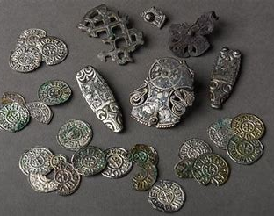
To further evidence that Vikings came to Norfolk there has been several historical findings such as the Hingham hoard. This was some of King Edmund’s jewellery which was buried to stop the Vikings from stealing it. It contained four silver brooches, two silver strap-ends and twenty-three silver pennies and it was found in 2012.
Another finding was in 1998, when the Forum in Norwich was being built. A rare Viking gold ingot was found and also part of a crucible with gold residues.

Slide 6
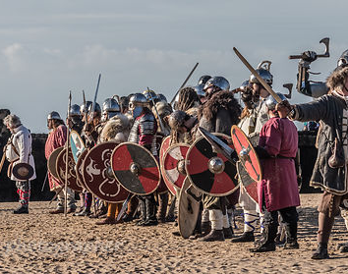
In conclusion, there is a lot of strong evidence to demonstrate that Vikings have been in Norfolk. As already detailed, this evidence includes changes to our language, findings of Viking items in Norfolk and names of villages in our area.
By Jacob

