Slide 1
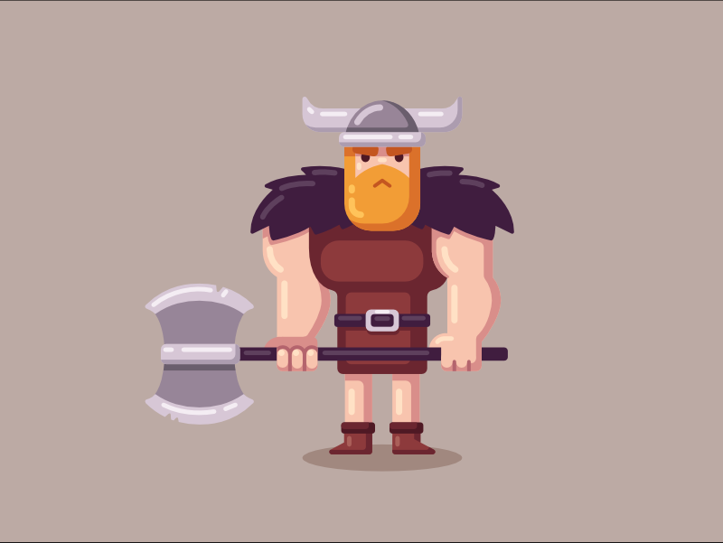
Vikings in Norfolk
By Jaydon Sims

Slide 2
Introduction
Vikings first came to our country on the 8th of June 793AD.
It is believed to be around 70 years later when they arrived in Norfolk.
The Vikings attacked Norfolk in 865AD and four years later killed Edmund, the last king of the East Angles.
Villages on the former island of Flegg with names such as Scratby, Hemsby and Filby provide evidence of Viking settlement: other place-names of Viking origin are scattered around Norfolk.
It is not known when Danish Vikings settled in Norwich but it is likely to have been in the late 880s. They rapidly settled down with the local Anglo-Saxons to live in an Anglo-Scandinavian town. This town was badly damaged by a raid of King Swein of Denmark in 1004.
Norfolk was part of the kingdom of the East Angles during the time of the Vikings. The name Norfolk means “northern people”. As the Vikings came from the North and settled here I believe this is who they meant as Northern people.

Slide 3
Viking Timeline
70 years later they arrived in Norfolk
Vikings were defeated in 1917AD
793AD Vikings
First came to England
900AD, Vikings first settled in Sheringham
Thors hammer found in 2003

Slide 4
Evidence of Vikings in Norfolk

Slide 5
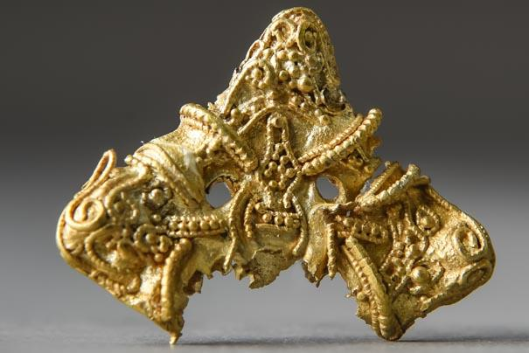
Viking Artefacts Found In Norfolk
Attlebourough - Gold Brooch
A unique gold brooch was found in Attlebourough. It was possibly made in Scandinavia before being brought to England.
This brooch probably belonged to someone very important. It was made from gold sheet with filigree wire inlays which would have been made in Scandinavia and brought over to England by the Vikings . Lozenge brooches were a typically Scandinavian form of brooch which are relatively well known from England but this is unique in being made of gold.

Slide 6
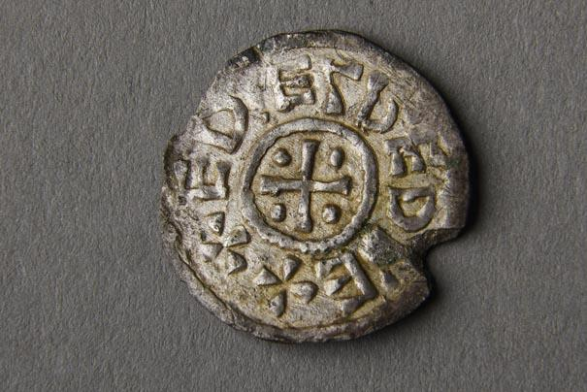
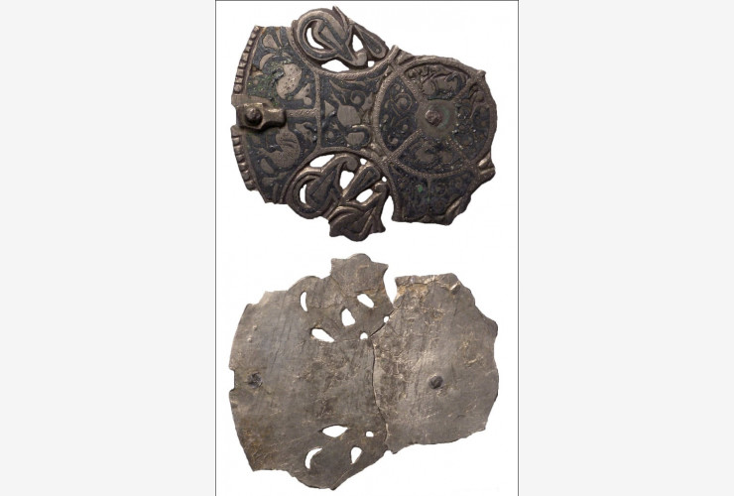
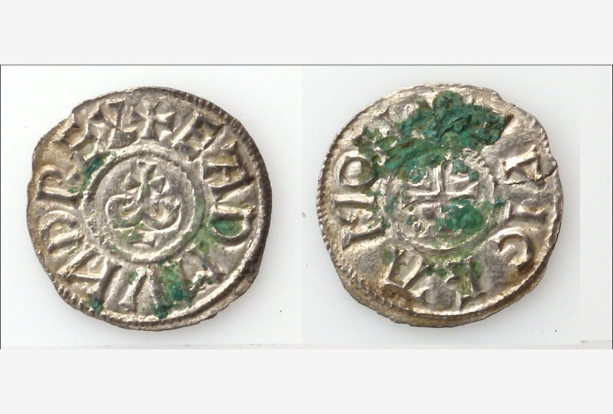
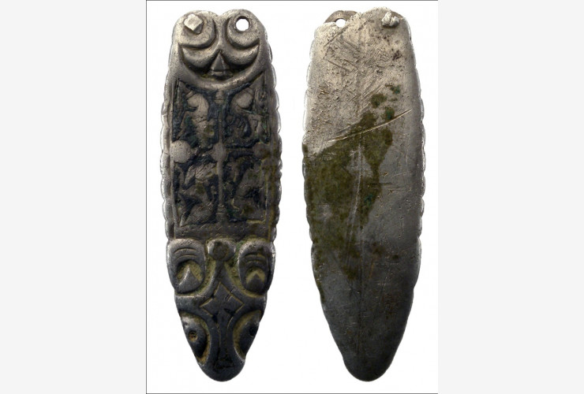
Hingham – Various items found
4 silver brooches.
23 silver penny's of King Edmund
2 silver penny's of King Ethelred.
It is most likely that this was Viking loot.

Slide 7
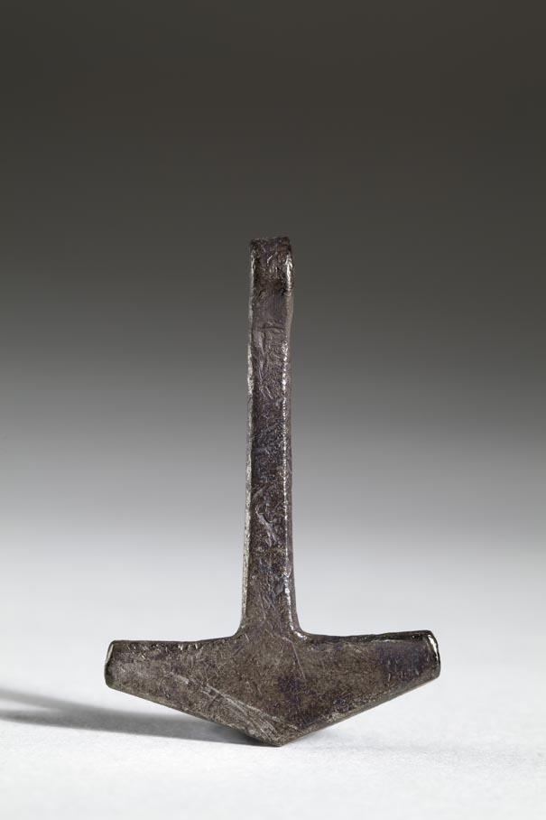
Great Witchingham – Silver Pendant
A silver and gold filigree Viking pendant in the shape of Thor’s hammer, was found by a metal detectorist in 2003 on the banks of the river Wensum.
A silver Thor’s hammer. This silver hammer is a reminder of why the Anglo-Saxons called the Vikings heathens, as they believed in pagan gods. Like a Christian wearing a cross, this pendant was worn as an amulet hoping for Thor’s protection.

Slide 8
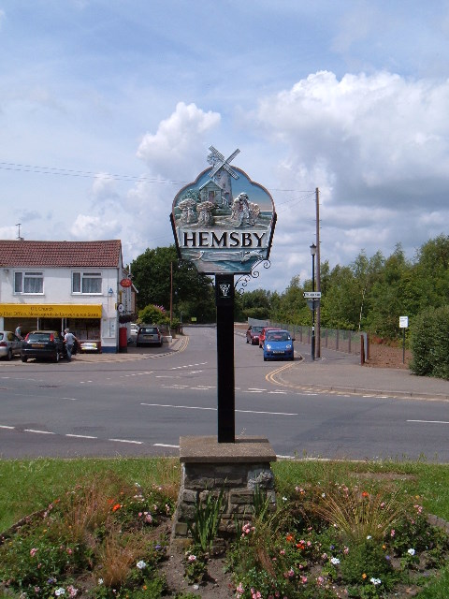
Here are some Viking villages names in Norfolk.
Hemsby
Scratby
Filby
Billockby
Colby
Sherringham

Slide 9
In Norfolk we can still trace the evidence of Vikings occupation in words and place-names. In the process they changed our language and they soon started mixing with the Anglo-Saxons. The Norfolk language includes many Danish words, such as the ones on the last slide. Staithe is a term unknown in England outside the East Coast (this includes Yorkshire as well as Norfolk); it means wharf and comes from Old Norse. Flegg is the name of the old hundred just outside Great Yarmouth and the word means the yellow flag iris in the Danish language. The area around the upper reaches of the river Wensum is particularly rich in such memorials of a time over a thousand years ago. The village of Elsing takes its name from a Danish chieftain ‘Elesa’. The forest called Normans Burrow Wood near Whissonsett has nothing to do with rabbit burrows; it is a corruption of ‘Norseman’s Barrow”. The village Newton Flotman comes from the Old Norse word for seaman. Here street names such as Colegate, Fishergate, Gildengate, Snaygate (now St Georges Street) and Finkelgate reveal Viking ancestry because “gata” is Old Norse for “street.”

Slide 10
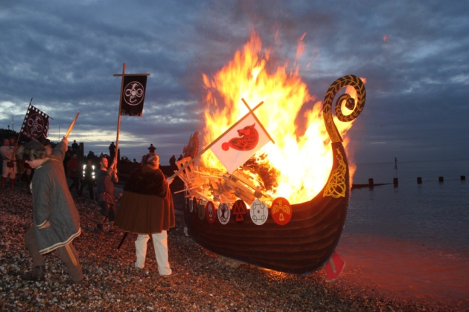
https://youtu.be/N05mM4501ak
Sherringham
The town’s name is Scandinavian origin and has the meaning, The Ham of Scira’s people. In 900AD, Vikings first settled in Sheringham and it is thought that Scira may have been a Viking warlord who was given the land as a reward for his performance in battle. This history is celebrated with the annual Viking Festival each winter.
Please copy and paste the links they are about the sherringham Viking festival which takes place every year. These are 2020 festival videos. Please use google chrome.

Slide 11
Hingham
As Viking armies swept across the land, wealthy Anglo Saxons hid their treasure. The first Viking raiders came looking for gold and silver, but later waves of invaders began settling on the rich land, taking over farms, villages and towns.
The 23 silver coins of King Edmund, and four brooches, hidden on land near Hingham would have represented enormous riches.

Slide 12
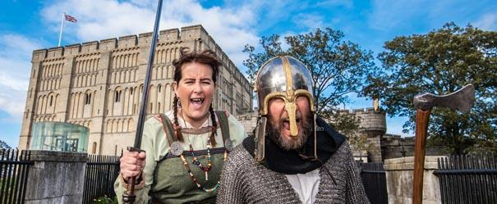
Norwich
No buildings survived from the Viking era in Norwich. But beneath the ground close to Agricultural Hall Plain are the remains of an ancient Viking church. There are quiet a few of Norwich churches which appeared to have Viking links, such as St Clement’s in Colegate dedicated to a saint frequently honoured by Vikings, and two former St Olaf’s churches, faithful to a martyred Norwegian king. A former church at Rose Lane in the 10th century found a Scandinavian burial cross on the site. Viking Norwich was concentrated on the northern bank of the Wensum, in the area known as Norwich over the water.

Slide 13
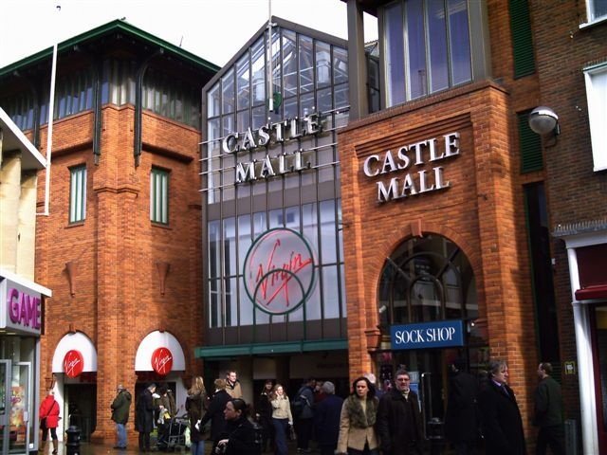
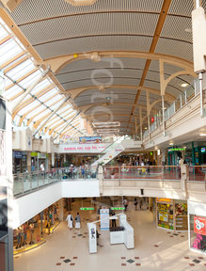
Castle Mall
Castle Mall occupies part of the Anglo-Scandinavian town. Remains of wood buildings with cellars, similar to those found at Coppergate, York. This was discovered by excavation between 1989 and 1991.
This is castle mall right now.

Slide 14
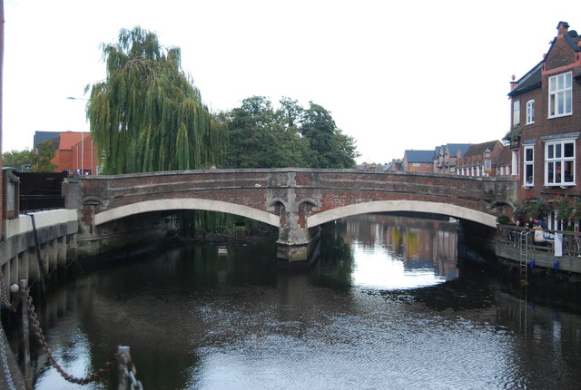
Fye Bridge
A wooden causeway formed the first river crossing here. Remains were seen in 1896 and again in 1999 - the causeway linked the main Danish settlement on the north bank of the River Wensum to a growing settlement on the south bank.

Slide 15
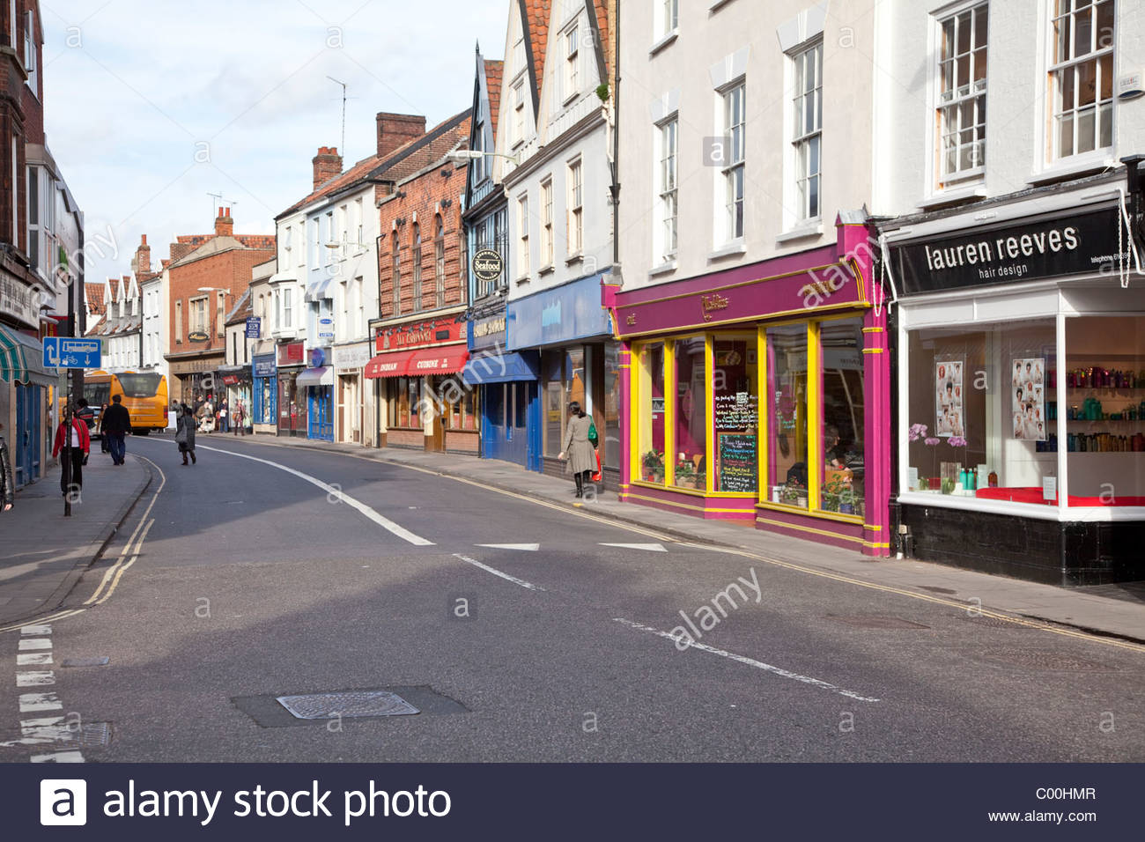
Magdalen Street
Magdalen Street was the main street in the Anglo-Scandinavian town of Norwich. To begin with it was called Fybriggate; meaning the street leading to Fye Bridge. Coins minted in the 10th century with the name Norvic were probably made here. This area was burnt down by King Sweyn in 1004.

Slide 16
Famous Viking in Norfolk
The Great Heathen Army of Viking raiders from Denmark, Norway and Sweden spent their winter in Thetford in the 860s. Led by three brothers, including Ivar the Boneless. They set out from the town on a campaign to commite crime across England.
The only still-standing Viking earthwork in Norfolk is in Thetford.
In the 10th century Thetford had its own mint with its coins found in Scandinavia. But at the beginning of the 11th century Viking troops led by the leader Thorkell the Tall and King Sweyn Forkbeard of Denmark and Norway arrived and poor Thetford was raided and burnt.

Slide 17
Viking language in Norfolk?
English | Old Norse | Old Norse meaning
Club | Klubba | A heavy, blunt weapon
sale | Sala | No meaning
Steak | Steik | To fry
skate | Skata | A kind of fish
Bull | Boli | No meaning
Muck | Myki | Cow dung
call | kalla | to cry loudly
English | Old Norse | Old Norse meaning
skin | skinn | Animal hide
Kid | kið | Young goat
Happy | happ | Good luck; fate
Choose | kjósa | No meaning
law | Lag | No meaning
Bark | bǫrkr | No meaning
Crawl | Krafla | To claw

Slide 18
Conclusion
Edward the Elder who was king of the Anglo Saxons from 899 and the oldest son of Alfred The Great, conquered East Anglia and ended Viking domination in 917AD. This region (which now includes the County of Norfolk) was then absorbed into the newly created kingdom of England.
Although its been hundreds of years since the Vikings terrorised our County, we still have festivals to remember the Vikings presence here.
I have discovered that there have been lots of Viking finds in Norfolk so I will be keeping my eyes peeled when out walking in case I stumble across some Viking treasure.
I have learnt that there is still some trace of Viking in the language that we use today and what certain words means in old Norse.
I could even have traces of Viking in me because of my blue eyes and blonde hair, which is a trait of people from Scandinavia like the Vikings!

