Slide 1
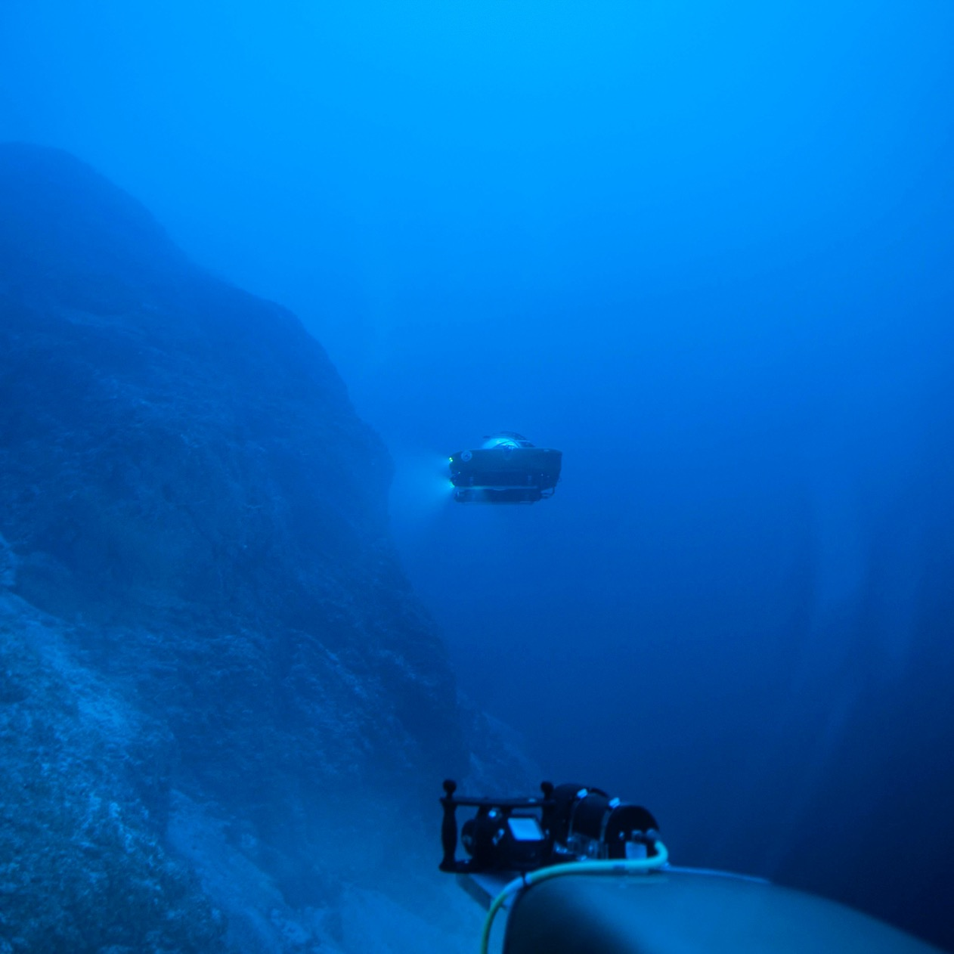
Why should we explore the ocean depths?
https://encounteredu.com/multimedia/videos/nekton-mission-2-the-indian-ocean-full-length

Slide 2
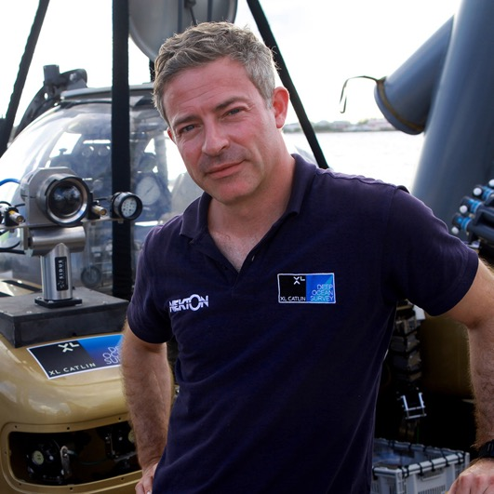
Lesson 1: How big and how deep is the ocean?
Mission brief
Hello trainee submariners!
I’m Oliver Steeds, Nekton’s Mission Director. Welcome to the team.
Over the next few lessons, you will be exploring the deep sea and researching what it takes to design and build a submarine.
At the end of the project, you will understand how forces and materials affect deep sea exploration and know why this type of exploration is so important.
You’ll hear from me regularly. I’m looking forward to working with you!
Good luck!
Oliver Steeds

Slide 3
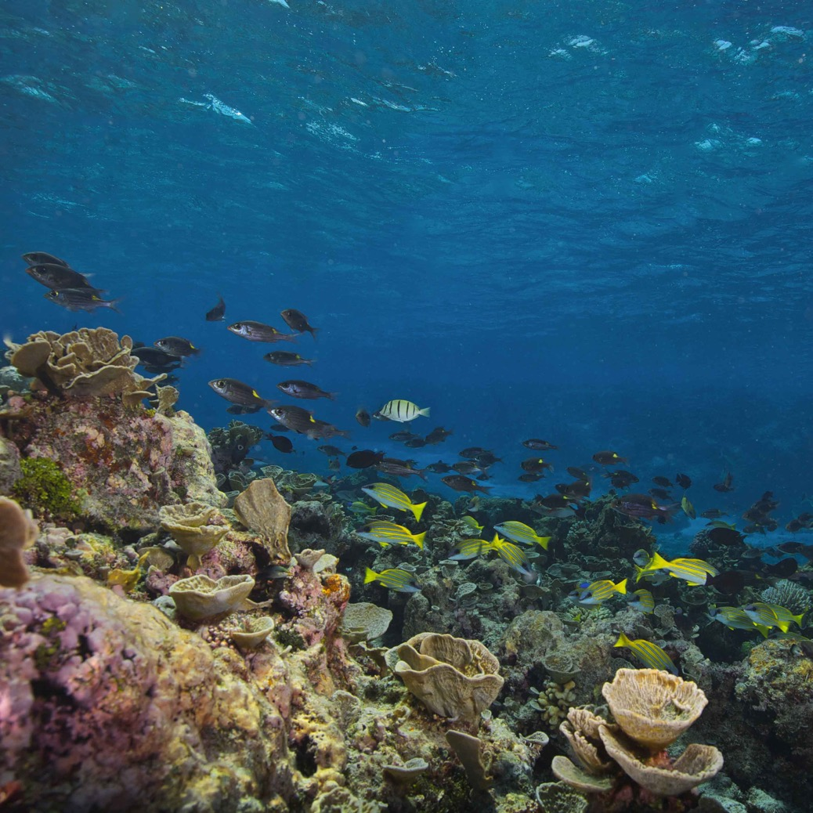
Lesson 1: How big and how deep is the ocean?
What do you know about the ocean?

Slide 4
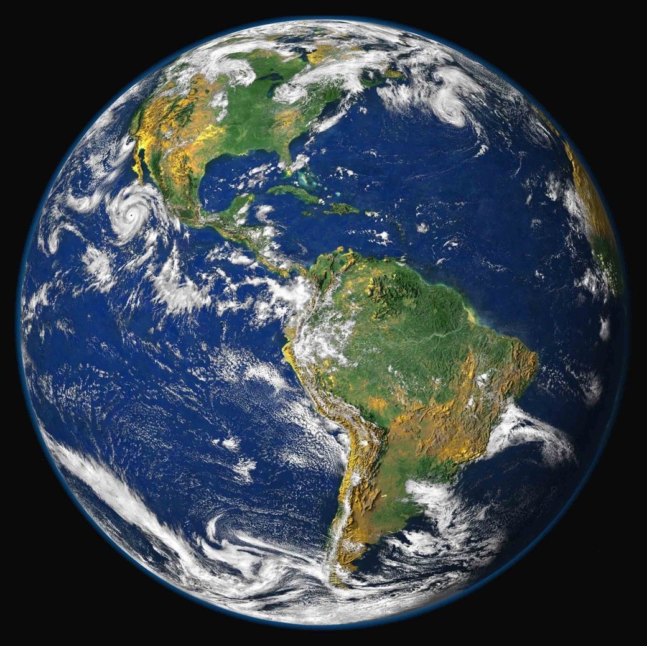
Lesson 1: How big and how deep is the ocean?
The Blue Planet
71% of our planet is covered in water.
The ocean produces half the oxygen we breath.
It captures 16 times the carbon compared with land.

Slide 5
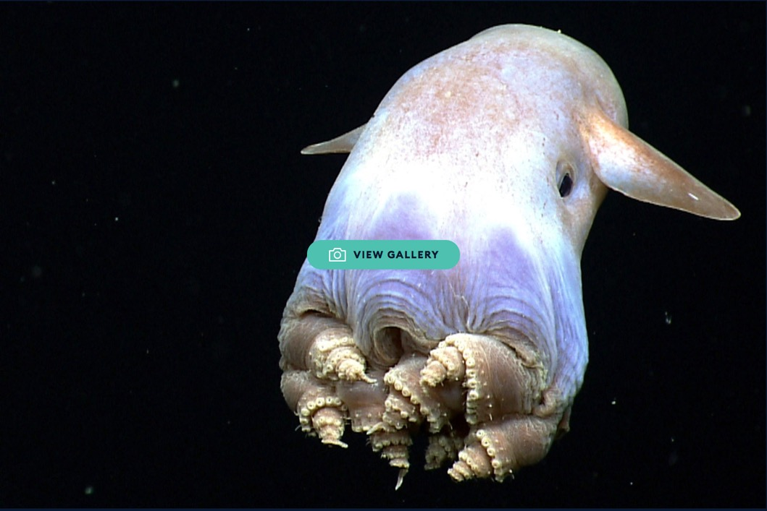
Lesson 1: How big and how deep is the ocean?
Deep-sea creatures
VIEW GALLERY
Notes:
Follow link through in Slideshow mode to access the online gallery.

Slide 6
Lesson 1: How big and how deep is the ocean?
Home Learning
Watch the video.
Think about what it would be like to experience deep sea exploration,
how would it feel?
Why is this type of exploration important?
Visit…
https://youtu.be/b0KUbgrQ5gc

